Slide 1
NBSD COVID-19
UNCLASSIFIED
Safety Tips

Slide 2
INTRODUCTION
UNCLASSIFIED
Coronavirus Disease 2019 (COVID-19) is a respiratory disease caused by the SARS-CoV-2 virus. It has spread from China to many other countries around the world, including the United States. Depending on the severity of COVID-19’s international impacts, outbreak conditions—including those rising to the level of a pandemic—can affect all aspects of daily life, including travel, trade, tourism, food supplies, and financial markets.
Older adults and people who have severe underlying medical conditions like heart or lung disease or diabetes seem to be at higher risk for developing more serious complications from COVID-19 illness.
There is currently no vaccine to prevent coronavirus disease 2019 (COVID-19).

Slide 3
UNCLASSIFIED
What is Coronavirus?

Slide 4
HOW IT SPREADS
UNCLASSIFIED
It is thought to spread primarily from person to person, mainly through respiratory droplets produced when an infected person coughs or sneezes. These droplets can land in the mouths or noses of people who are nearby or possibly be inhaled into the lungs. Spread is more likely when people are in close contact with one another (within about 6 feet). It may be possible that a person can get COVID-19 by touching a surface or object that has the virus on it and then touching their own mouth, nose, or possibly their eyes. This is not thought to be the main way the virus spreads, but we are still learning more about this virus.
The virus that causes COVID-19 is spreading very easily and sustainably between people. Information from the ongoing COVID-19 pandemic suggests that this virus is spreading more efficiently than influenza, but not as efficiently as measles, which is highly contagious.

Slide 5
UNCLASSIFIED
The best way to prevent illness is to avoid being exposed to this virus. You can take steps to slow the spread.
Maintain good social distance (about 6 feet). This is very important in preventing the spread of COVID-19.
Wash your hands often with soap and water. If soap and water are not available, use a hand sanitizer that contains at least 60% alcohol.
Routinely clean and disinfect frequently touched surfaces.
Self-quarantine / seek medical attention if you feel sick or have symptoms.
How to Protect Yourself & Others

Slide 6
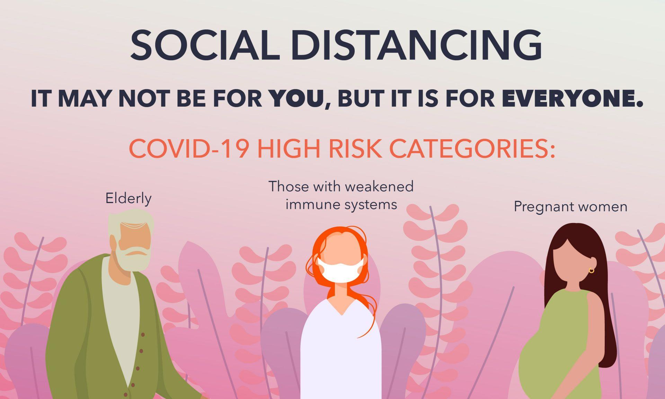
UNCLASSIFIED
In addition to everyday steps to prevent COVID-19, keeping space between you and others is one of the best tools we have to avoid being exposed to this virus and slowing its spread locally and across the country and world.
Limit close contact with others outside your household in indoor and outdoor spaces. Since people can spread the virus before they know they are sick, it is important to stay away from others when possible, even if you—or they—have no symptoms. Social distancing is especially important for people who are at higher risk for severe illness from COVID-19.

Slide 7
What is social distancing?
UNCLASSIFIED
Social distancing, also called “physical distancing,” means keeping space between yourself and other people outside of your home. To practice social or physical distancing:
Stay at least 6 feet (about 2 arms’ length) from other people
Do not gather in groups
Stay out of crowded places and avoid mass gatherings

Slide 8
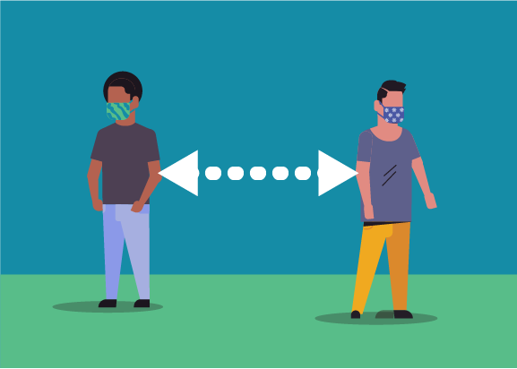
UNCLASSIFIED
TIPS FOR SOCIAL DISTANCING
Follow guidance from authorities where you live and work.
If you need to shop for food or medicine at the grocery store or pharmacy, stay at least 6 feet away from others. Also consider other options:
Use mail-order for medications, if possible.
Consider a grocery delivery service.
Cover your mouth and nose with a cloth face covering when around others, including when you have to go out in public, for example to the grocery store.
Cloth face coverings should NOT be placed on children under age 2, anyone who has trouble breathing, or is unconscious, incapacitated, or otherwise unable to remove the mask without assistance.
Keep at least 6 feet between yourself and others, even when you wear a face covering.

Slide 9
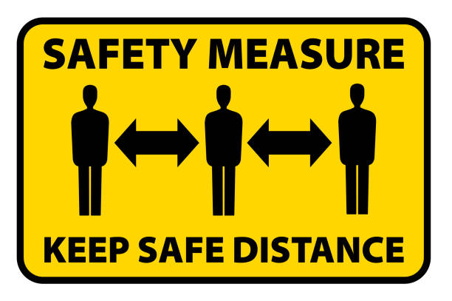
UNCLASSIFIED
SOCIAL DISTANCING
Avoid gatherings of any size outside your household, such as a friend’s house, parks, restaurants, shops, or any other place. This advice applies to people of any age, including teens and younger adults. Children should not have in-person playdates while school is out.
Work from home when possible.
Avoid using any kind of public transportation, ridesharing, or taxis, if possible.
If you are a student or parent, talk to your school about options for digital/distance learning.

Slide 10
FACE COVERING
UNCLASSIFIED
CDC recommends wearing cloth face coverings in public settings where other social distancing measures are difficult to maintain (e.g., workspaces, grocery stores and pharmacies), especially in areas of significant community-based transmission.
Cloth face coverings should not be placed on young children under age 2, anyone who has trouble breathing, or is unconscious, incapacitated or otherwise unable to remove the mask without assistance.
How to Wear a Cloth Face Covering
Cloth face coverings should –
Fit snugly but comfortably against the side of the face covering the mouth and nose
Be secured with ties or ear loops
Include multiple layers of fabric
Allow for breathing without restriction
be able to be laundered and machine dried without damage or change to shape

Slide 11
RESPIRATORS
UNCLASSIFIED
N95 Respirators are not authorized for general use on Naval Base San Diego unless you are currently enrolled in your commands respirator program.
N95 Respirators can cause problems for personnel with underlying medical conditions and make it more difficult for the wearer to breathe. Medical surveillance is required.
N95 Respirators require a written program for standard operating procedures. The following are elements of the program:
Training respirator wearers
Fit Testing
Medical surveillance
Inspection
Monitoring hazards
Operating procedures
Cleaning, storage, & maintenance

Slide 12
HANDWASHING
UNCLASSIFIED
Regular handwashing is one of the best ways protect yourself, your family and your co-workers from getting sick.
Washing hands can keep you healthy and prevent the spread of respiratory and diarrheal infections from one person to the next. Germs can spread from other people or surfaces when you:
Touch your eyes, nose, and mouth with unwashed hands
Prepare or eat food and drinks with unwashed hands
Touch a contaminated surface or objects
Blow your nose, cough, or sneeze into hands and then touch other people’s hands or common objects
During the Coronavirus Disease 19 (COVID-19) pandemic, keeping hands clean is especially important to help prevent the virus from spreading.

Slide 13
WASHING HANDS CORRECTLY
UNCLASSIFIED
Follow these five steps every time.
Wet your hands with clean, running water (warm or cold), turn off the tap, and apply soap.
Lather your hands by rubbing them together with the soap. Lather the backs of your hands, between your fingers, and under your nails.
Scrub your hands for at least 20 seconds. Need a timer? Hum the “Happy Birthday” song from beginning to end twice.
Rinse your hands well under clean, running water.
Dry your hands using a clean towel or air dry them.

Slide 14
HAND SANITIZER
UNCLASSIFIED
Use Hand Sanitizer When You Can’t Use Soap and Water
Washing hands with soap and water is the best way to get rid of germs in most situations. If soap and water are not readily available, you can use an alcohol-based hand sanitizer that contains at least 60% alcohol. You can tell if the sanitizer contains at least 60% alcohol by looking at the product label.

Slide 15
Sanitizers can quickly reduce the number of germs on hands in many situations. However,
UNCLASSIFIED
Sanitizers do not get rid of all types of germs.
Hand sanitizers may not be as effective when hands are visibly dirty or greasy.
Hand sanitizers might not remove harmful chemicals from hands like pesticides and heavy metals.

Slide 16
HOW TO CLEAN & DISINFECT
UNCLASSIFIED
Wear reusable or disposable gloves for routine cleaning and disinfection.
Clean surfaces using soap and water, then use disinfectant.
Cleaning with soap and water reduces number of germs, dirt and impurities on the surface. Disinfecting kills germs on surfaces.
Practice routine cleaning of frequently touched surfaces. High touch surfaces include:
Tables, doorknobs, light switches, countertops, handles, desks, phones, keyboards, toilets, faucets, sinks, etc.
Bleach solutions will be effective for disinfection up to 24 hours.
Alcohol solutions with at least 70% alcohol may also be used.
Consider putting a wipeable cover on electronics.
Follow manufacturer’s instruction for cleaning and disinfecting.

Slide 17
Returning to the New Reality
UNCLASSIFIED
Considerations for post COVID-19 workforce management

Slide 18
STEPS BACK TO A NEW REALITY
UNCLASSIFIED
As we start to consider the easing of lockdown and a return to options of working a flexible schedule, not just remotely, there are a number of elements to implement and plan:
Priority groups – Who are a priority for returning to work on-site?
Scheduling – How do we group teams to be in the same physical space?
Health & Wellbeing – Continued support of additional health and wellbeing measures, both on-site and virtually.
Effective working – Designing how personnel will work together combining face to face with virtual, to ensure consistent interactions.
Employee engagement – Continued engagement through communications at all levels and across office based and virtual teams.
Technology – Management of technology and networks to cope with combination of in-house and remote access.
Policy – Update and redesign policies and procedures to include the new working practices.
Facilities & workplace – Update and re-organize office / working spaces to serve remote and face to face simultaneously.

Slide 19
UNCLASSIFIED
NBSD GUIDANCE
Limit unnecessary movements around the base.
When accessing NBSD ensure that you have your ID Card ready.
Follow sentry’s instructions.
Hold ID Card up so the sentry can scan the card.
Ensure any face coverings or sunglasses are removed for visual verification.
Roll down rear windows if tinted.
Follow all traffic patterns, as they may change daily.
Practice social distancing when moving around the base.
Smoke pits, lunch / break areas, exercise fields, both indoor and outdoor workspaces.
Ensure face coverings are worn when 2 or more people are in a GOV (Government vehicle) or golf cart.

Slide 20
UNCLASSIFIED
COMMANDING OFFICER
I can not thank each of you enough for your individual sacrifices you and your families are making to ensure our Navy remains ready to respond. Our role as sworn defenders of our Nation and our Constitution, and our support to our larger base community, is continuing to set an example for both our Navy and our neighbors. We are ensuring sailors are lodged and well-fed, providing security to our installation and assets, getting ships underway, executing installation safety and environmental response, taking care of children for our active duty shipmates and family, ensuring emergency services function, continuing operation of our facilities and infrastructure, and the increasingly important role of our Navy Exchange and Commissary teams. Thank you to you and your families for the dedication and professionalism you continue to display each and every day!
Very Respectfully,
Stay Safe, Capt. M. Nieswiadomy
Stay Healthy! Commanding Officer
Naval Base San Diego

Slide 21
Stay Safe, Stay Healthy, & Stay Strong
UNCLASSIFIED
Thank you

